Slide 1

E-Commerce Management System
Stream: CSE(AIML)
Date of submission: 17/10/2023
Name: Debdeep Bhowmick
Enrolment Number: 12021002016057
Roll Number: 39
Name: Tanuj Chaudhuri
Enrolment Number: 12021002016059
Roll Number: 17

Slide 2
CONTENTS
Chapter 1: Introduction
1.1 Overview ………………………………………………………………………………………………………1
1.2 Background Study …………………………………………………………………………………………1
1.3 Project Planning ………………………………………………………………………………………….. 2
1.4 Purposes ………………………………………………………………………………………………………2 Chapter 2: System Design
2.1 Design ………………………………………………………………………………………………………….3
2.2 User Characteristics ……………………………………………………………………………………..3
2.3 System Information ………………………………………………………………………………………4
2.4 System Analysis ……………………………………………………………………………………………4
2.5 Feasibility Analysis ………………………………………………………………………………………..4
2.6 Context Design ………………………………………………………………………………………………5 Chapter 3: Hardware and Software Requirement
3.1 Hardware Required ………………………………………………………………………………………6
3.2 Software Required ……………………………………………………………………………………6 Chapter 4: Implementing Tools for the Project
4.1 Tools ……………………………………………………………………………………………………………7
4.2 What is XAMPP ……………………………………………………………………………………………7
4.3 What is included in XAMPP ………………………………………………………………………….7
4.4 HTML ……………………………………………………………………………………………………………8
4.5 CSS ……………………………………………………………………………………………………………….8
4.6MySQL ………………………………………………………………………………………………………….9 Chapter 5:
Project Database & Table5.1
Database Design ……………………………………………………………………………………………10
5.2 All Table List ………………………………………………………………………………………………….11
5.3 Admin table …………………………………………………………………………………………………..11
5.4 Category table ………………………………………………………………………………………………………11

Slide 3
5.5 Product table …………………………………………………………………………………………………12
5.6 Category table ……………………………………………………………………………………………….12
5.7 Brand table …………………………………………………………………………………………………….13
5.8 Cart table ……………………………………………………………………………………………………….13
5.9 Order table …………………………………………………………………………………………………....13 Chapter 6: Project Model View
6.1 Home page……………………………………………………………………………………………………14
6.2 Single product page ……………………………………………………………………………………….14
6.3 Cart page ……………………………………………………………………………………………………….14
6.4 Checkout page ……………………………………………………………………………………………….15
6.5 Admin login page …………………………………………………………………………………………..15
6.6 Add Brand page ……………………………………………………………………………………………..16
6.7 Brand List page ………………………………………………………………………………………………17
6.8 Add Category page …………………………………………………………………………………………17 Chapter 7: Software Testing
7.1 Why Software Testing is Needed……………………………………………..18 7.2 Testing Strategy…………………………………………………………………19

Slide 4
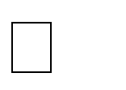
Chapter One
Introduction
Overview
The "Online E-commerce Web application" Services division aspires to offer solutions to build and transmit in a simple and effective method in the digital era and to aid in lowering human pressure and time. It offers services such as the digitization of analogue artefacts, metadata management,
digital preservation, and discovery and access to digital collections to support shop collections, digital initiatives, and external partner institution digital projects. A website called "Ecomm" was created for all operating systems with the aim of assisting users in maintaining and organising virtual shops. Both novice and seasoned users will find this program to be simple to use. It has a recognisable, well-
designed, and appealing user interface, as well as robust reporting and searching functions.
Background Study
E-commerce is snappily getting a recognised and extensively utilised business model. further and further businesses are creating websites with capability for conducting marketable deals over the
internet. It's respectable to argue that online purchasing is getting more wide. This design's thing is to produce a general- purposee-commerce store where any goods( similar as books, CDs, computers, mobile phones, electrical bias, and home appliances) may be bought from the comfort of one's own home over the Internet. still, for the sake of perpetration, this study will concentrate on an online
ecommerce business. A virtual store on the Internet where guests may explore the roster and pick goods of interest is known as an online store. The chosen products can be gathered in a shopping wain. Usually, the customer will be asked to fill or select a billing address, a shipping address, shipping option, and payment information such as a credit card number. An email notification is sent to the customer as soon as the order is placed.
Project Planning
Project planning is a component of design operation that involves the use of timetables similar to Gantt charts to plan and afterwards report progress within the design terrain. Initially, the design compass is established, and the styles that will be used to complete the design are determined. Following this, the time required to perform the colourful jobs is noted and arranged into a work breakdown structure. The logical dependencies between jobs are defined using an effort network diagram, which allows the crucial path to be identified. Design operation software may be used to determine float or relax time in the schedule. The required coffers may also be approximated, and costs for each activity can be assigned to each resource, yielding the overall design cost. The design is still in the early stages.
Purposes
The project is about to handle all the information of the shop regarding members. Also it manages resources which were managed and handled by manpower previously. The main purpose of the project is to integrate distinct sections of the shop into consistent manner so that complex functions can be handled smoothly. The project aims at the following matters
Automation of product manipulation. Buying products.
To manage information of different types of items. Consistently update information of all the item.
Managing security by providing authorized email & password. Manages database efficiently.

Slide 5
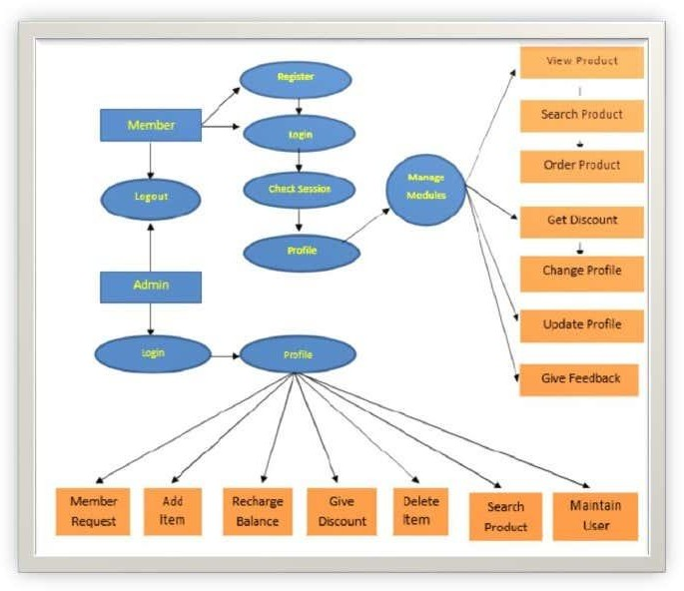
Chapter Two System Design
2.1 Design
The system is divided into some parts these are Register system, Login System, Search System, Buying System, Order Received System, Viewing System side with database represent the server using PHP ,MYSQL and APACHE with XAMPP server. System diagram and system database diagram.
Users Characteristics
The user can log in to the system by using his specific email and password. User can view the products and order the products according to their own needs. He can view his profile and update his details. He can update his personal information by logging into the system. Users can find various products by using the search option to easily update their details. He can update his personal information by logging into the system. Users can find various products by using the search option easily.
System Information
This system is an automated Shop Management System. Through the software user can add members, add products, search products, update information, edit information, buy the product in quick time. The system has the following advantages:
User-friendly interface Fast access to database Search facility
Look and Feel Environment

Slide 6
System Analysis
It refers to the process of examining a situation with the intent of improving it through better procedures and methods. System Analysis is the process of planning a new system to either replace or complement an existing system. But before any planning is done the old system must be thoroughly understood and the requirements determined. System analysis is therefore, the process of gathering and interpreting facts, diagnosing problems and using the information to recommend improvements in the system. System analysis is conducted with the following objectives in mind:
Evaluate the system concept for feasibility. Perform economic and technical analysis.
Allocate functions to hardware, software people, database and other system elements. Establish cost and schedule constraints.
Create a system definition that forms the foundation for all the subsequent engineering work.
Feasibility Analysis
Whatever we think need not be feasible. It is wise to think about the feasibility of any problem we undertake. Feasibility is the study of impact, which happens in the organization by the development of a system. The impact can be either positive or negative. When the positives nominate the negatives, then the system is considered feasible. Here the feasibility study can be performed in two ways such as technical feasibility and economic feasibility.
Technical Feasibility
It is technically feasible since there will not be much difficulty in getting the required resources for the development and maintenance of the system as well. All the resources are needed for the development of the software as well as the maintenance.
Economical Feasibility
The development of this application is highly economically feasible .The organization needed not spend much one for the development of the system already available. The only thing is to be done is making an environment for the development with an effective supervision. If we are doing so , we can attain the maximum usability of the corresponding resources . Even after the development , the organisation will not be in a condition to invest more in the organization. Therefore, the system is economically feasible.

Slide 7
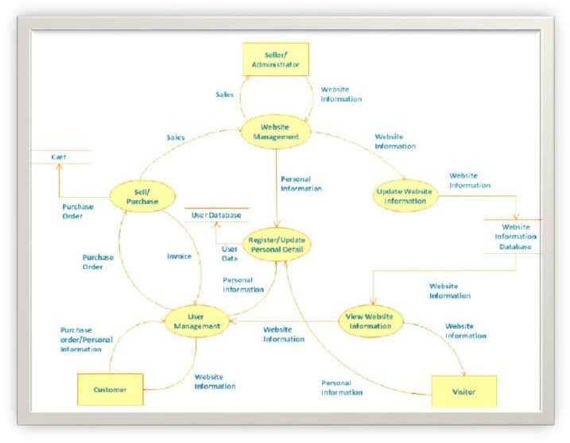
2.8 Context Diagram
Chapter Three
Hardware and Software Requirements
Hardware Required
Processor: Pentium IV or Above RAM: 2GB or above
Hard Disk:50GB or above
Input Devices: Keyboard, Mouse Output Devices: Monitor
Software Required
Operating System: Linux, Ubuntu, Mac, Windows XP, 7, 8, 8.1, 10 Frontend: HTML,CSS, Bootstrap, JavaScript
Backend: PHP, MySQL
Local host: XAMPP/WAMP/LAMP/MAMP

Slide 8
Chapter Four
Implementing Tools for the Project
Tools HTML CSS Bootstrap MySQL XAMPP
What is XAMPP?
XAMPP stands for Cross-Platform (X), Apache (A), MySQL (M), PHP (P) and Perl (P). It is a simple, lightweight Apache distribution that makes it extremely easy for developers to create a local webserver for testing purposes. Everything you need to set up a web server
server application(Apache), database (MySQL), and scripting language (PHP)
is included in a simple extractable file. XAMPP is also cross-platform, which means it works equally well on Linux, Mac and Windows. Since most actual web server deployments use the same components as XAMPP, it makes transitioning from a local test server to a live server extremely easy as well. Web development using XAMPP is especially beginner- friendly.
XAMPP has four primary components. These are:
Apache:
Apache is the actual web server application that processes and delivers web content to a computer. Apache is the most popular web server online, powering nearly 54% of all websites.
MySQL:
Every web application, however simple or complicated, requires a database for storing collected data. MySQL, which is open source, is the world’s most popular database management
system. It powers everything from hobbyist websites to professional platforms like WordPress.
PHP:
PHP stands for Hypertext Preprocessor. It is a server-side scripting language that powers some of the most popular websites in the world, including Word Press and Facebook. It is open source, relatively easy to learn, and works perfectly with MySQL, making it a popular choice for web developers.
Perl:
Perl is a high-level, dynamic programming language used extensively in network programming, system admin, etc. Although less popular for web development purposes.
HTML
Every webpage you look at is written in a language called HTML. You can think of HTML as theskeleton that gives every webpage structure. In this course, we'll use HTML to add paragraphs,headings, images and links to a webpage.
In the editor to the right, there's a tab called test.html. This is the file we'll type our HTML into. Like any language, it has its own special syntax. A browser's job is to transform the

Slide 9
code intest.html into a recognizable webpage! It knows how to lay out the page by following the HTML syntax.
CSS
Cascading Style Sheets (CSS) is a style sheet language used for describing the presentation of a document written in a markup language.[1] Most often used to set the visual style of web pages and user interfaces written in HTML and XHTML, and is applicable to rendering in speech, or on other media. Along with HTML and JavaScript, CSS is a cornerstone technology used by most websites to create visually engaging webpages, user interfaces for web applications, and user interfaces for many mobile applications.CSS is designed primarily to enable the separation of document content from document presentation, including aspects such as the layout, colors, and fonts.[3] This separation can improve content accessibility, provide more flexibility and control in the specification of presentation characteristics, enable multiple HTML pages to share formatting by specifying the relevant CSS in a separate. CSS file, and reduce complexity and repetition in the structural content.
MySQL
MySQL is a database system used on the web. MySQL is a database system that runs on a server. MySQL is ideal for both small and large applications. MySQL is very fast, reliable, and easy to use.
MySQL uses standard SQL.
MySQL compiles on a number of platforms. MySQL is free to download and use.
MySQL is developed, distributed, and supported by Oracle Corporation
Chapter Five
Project Database and Table
5.1
Database Design
Database is critical for all businesses. A good database does not allow any form of anomalies andstores only relevant information in an ordered manner. If a database has anomalies, it is affectingthe efficiency and data integrity. For example, delete anomaly arise upon the deletion of a rowwhich also forces other useful data to be lost. As such, the tables need to be normalized. Thisfulfils the last objective of ensuring data are accurate and retrieved correctly.Database files are the key source of information into the system. It is the process of designingdatabase files, which are the key source of information to the system. The files should be properlydesigned and planned for collection, accumulation, editing and retrieving the requiredinformation.
The organization of data in database aims to achieve three major objectives: - Data integration
Data integrity Data independence

Slide 10
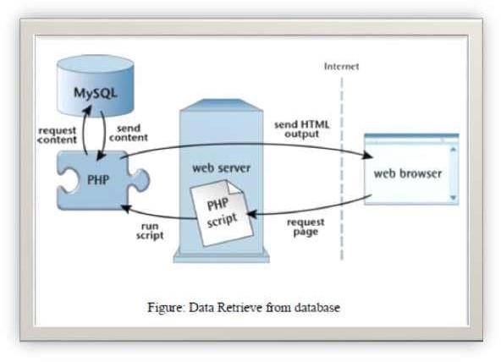
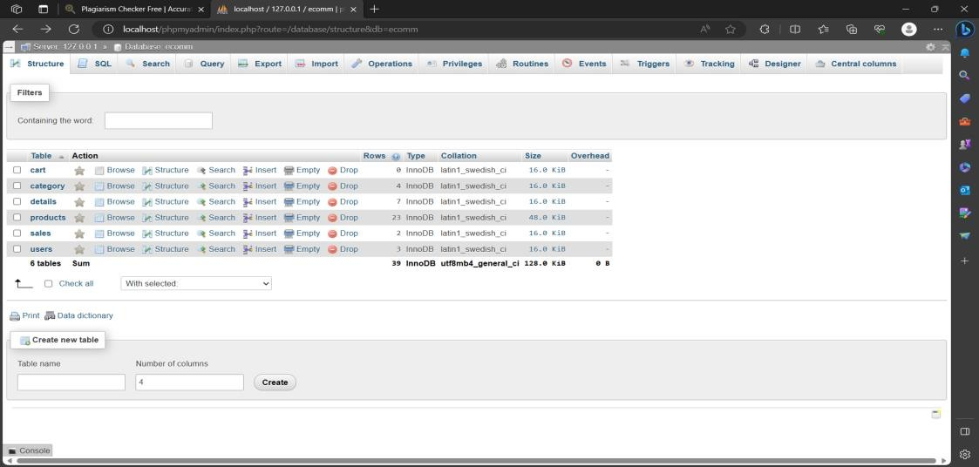
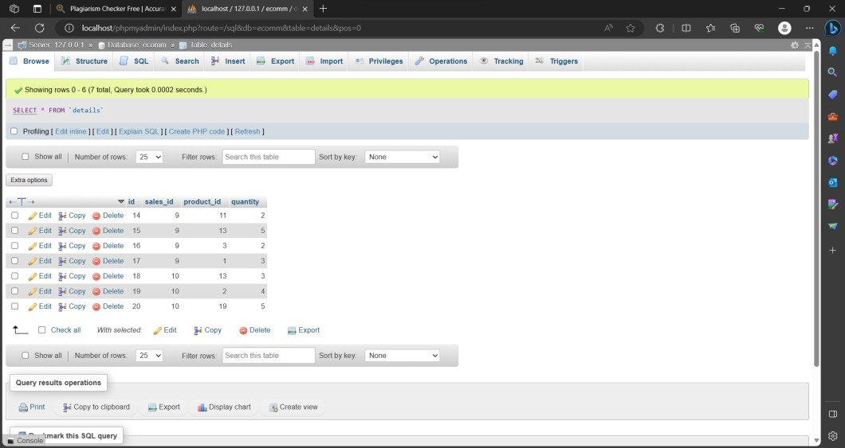
5.2 All Table list
5.3 Admin Table List

Slide 11
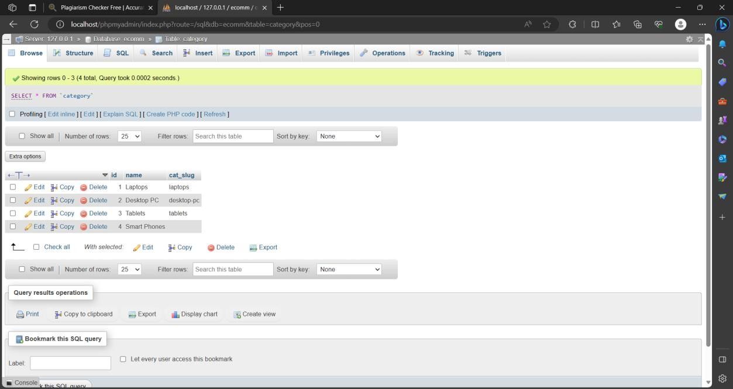
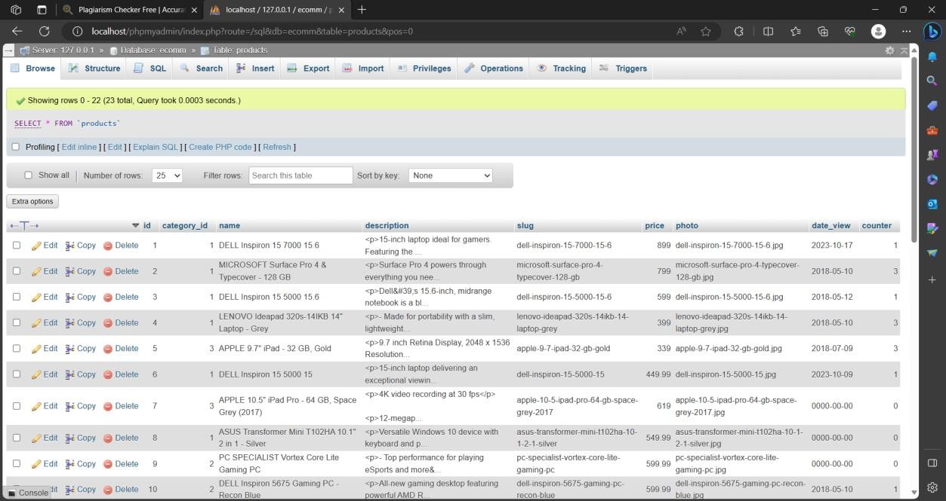
5.4 Category Table List
5.5 Product Table List

Slide 12
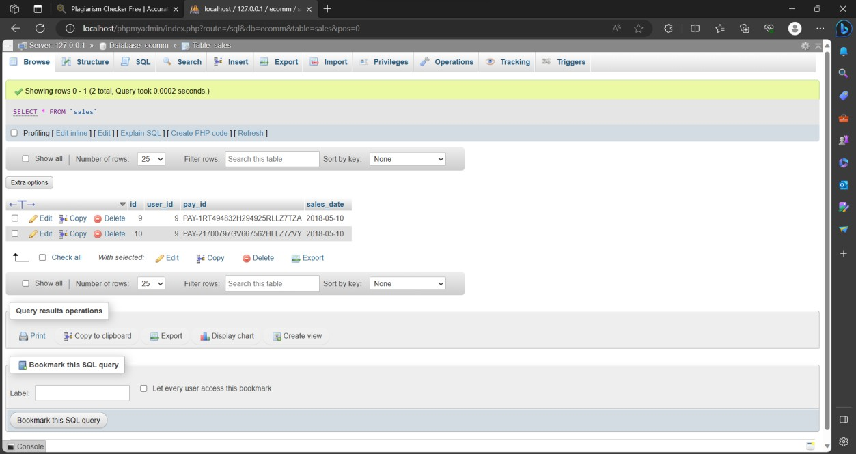
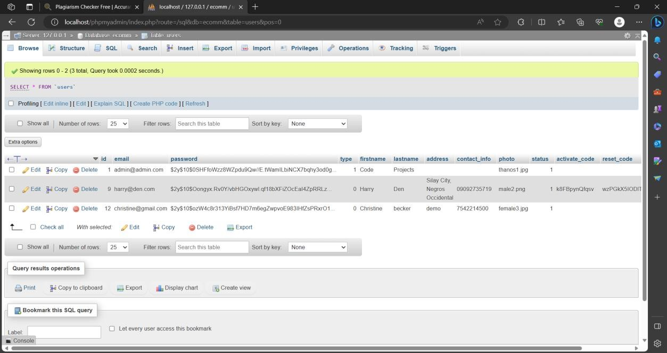
5.6 Cart List
5.7 Users List

Slide 13
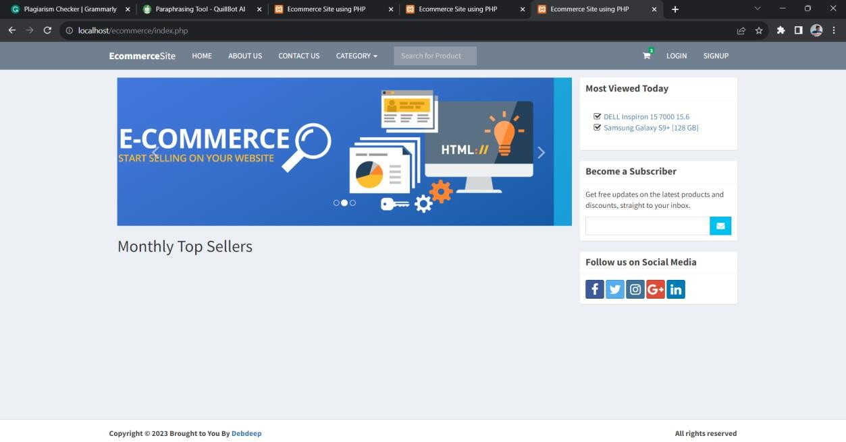
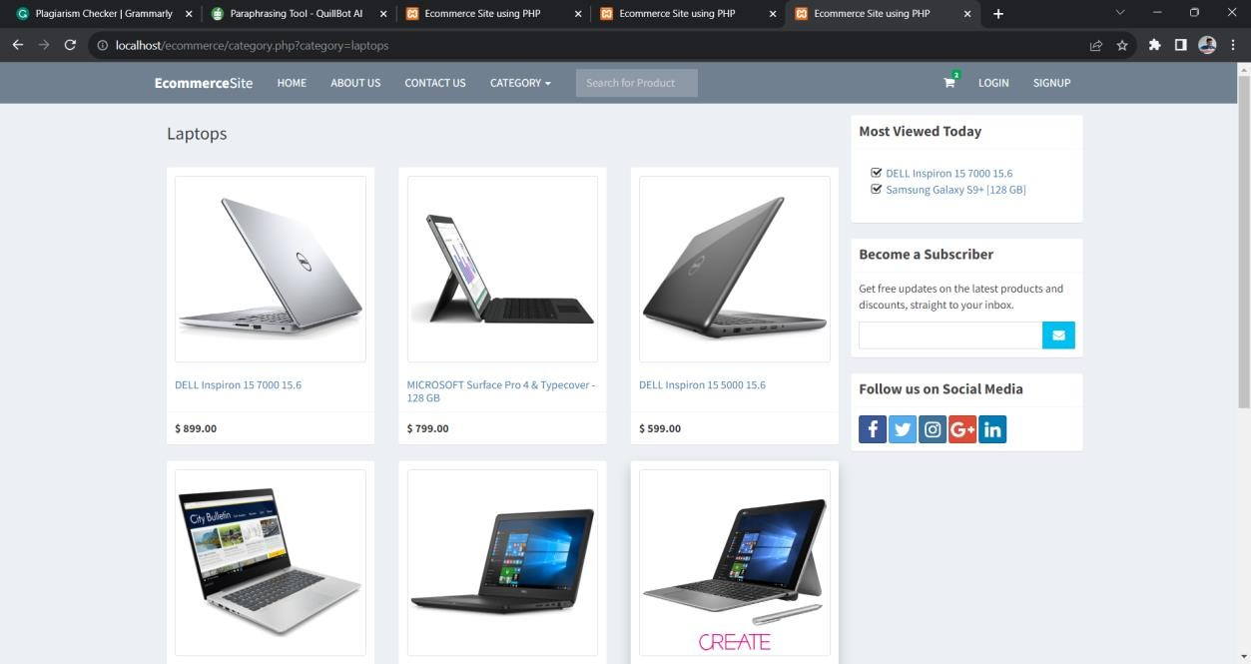
Chapter Six
Project Model View(ss)
6.1 Home Page
6.2 Product Page

Slide 14
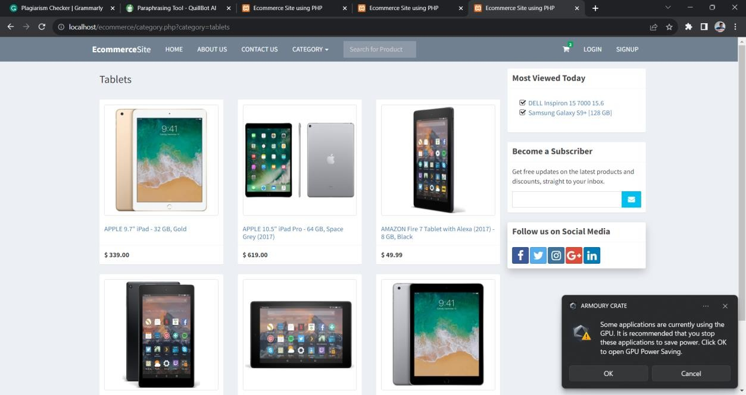
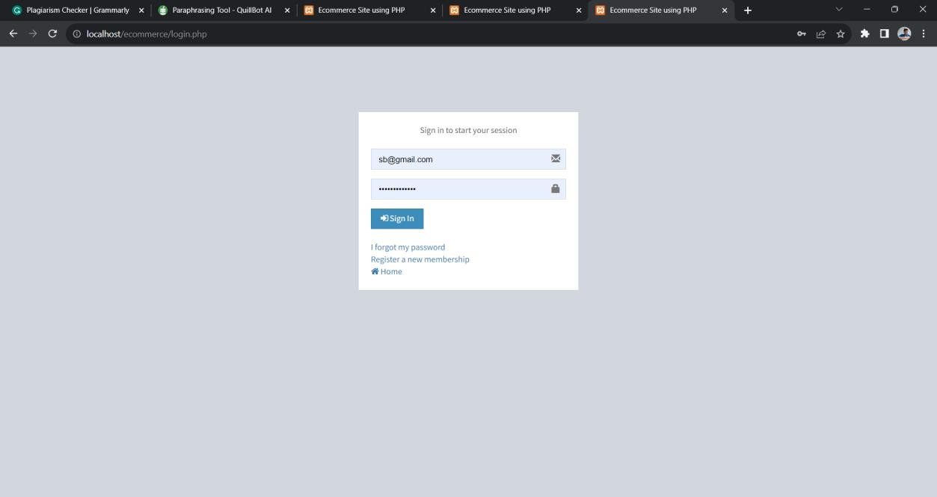
6.3 Sign-in page

Slide 15
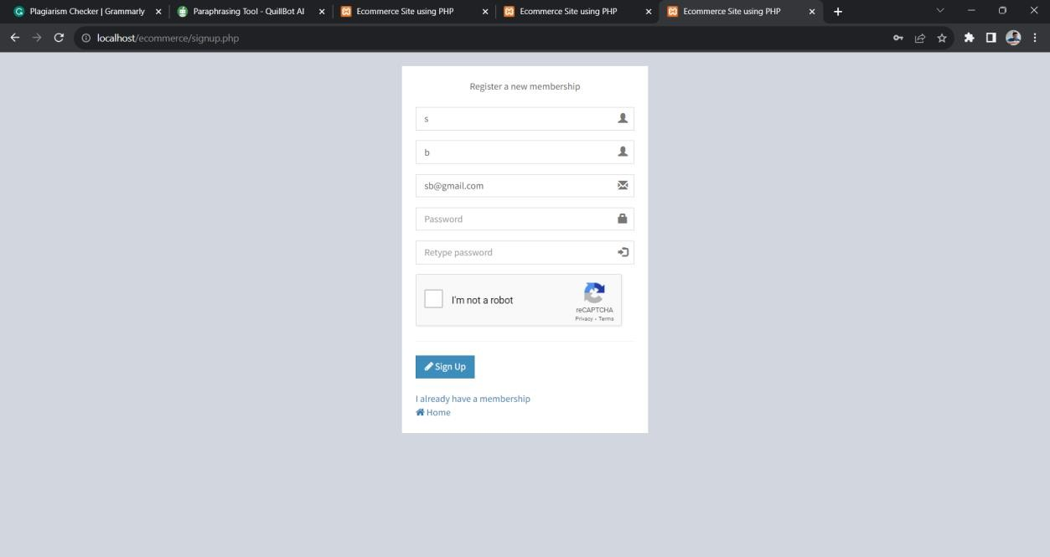
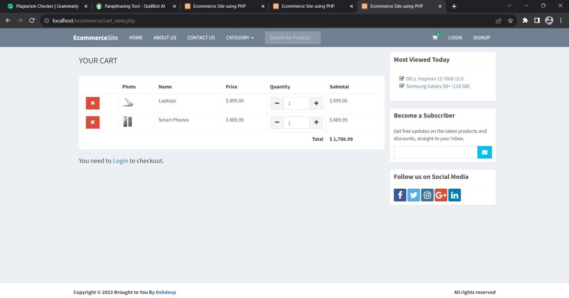
6.4 Register From
6.5 Cart

Slide 16
Chapter Seven Software Testing
Why Software Testing is Needed
Tool- bars work duly? Are all menu function and pull down sub function duly listed? Is it possible to bring each menu function using a logical hypotheticals that if all corridor of the systemare correct, the thing will be successfully achieved? In acceptable testing ornon-testing will leads to crimes that may appear many months latterly. Testing represents an intriguing anomaly for the software mastermind. During earlier software engineering conditioning, the mastermind attempts to make softwarefrom an abstract conception to a palpable product.
Now comes testing. The mastermind creates a series of
test cases that are intended to “ demolish ” the software that has been erected. In fact, testing is the one
step in the software process that could be viewed( psychologically, at least) as destructive ratherthan formative. Testing requires that the inventor discard preconceived sundries of the “ correctness ” of software just developed and overcome a conflict of interest that occurs when crimes
are uncovered.
If testing is conducted successfully( according to the objects stated preliminarily) it'll uncovererrors in the software. As a secondary benefit, testing demonstrates that software functionsappear to be working according to specification, that behavioral and performancerequirements appear to have been met. In addition, data collected as testing is conductedprovide a good suggestion of software trustability and some suggestion of software quality as awhole. But testing can not show the absence of crimes and blights, it can show only that software crimes and blights are present. It's important to keep this( rather caliginous) statement in mind as testing is being conducted.
Testing Strategy
There are types of testing that we implement. They are as follows: While deciding on the focus of testing activities, study project priorities. For example, for an online system, pay more attention to response time. Spend more time on the features used frequently. Decide on the effort required for testing based on the usage of the system. If the system is to be used by a large number of users, evaluate the impact on users due to a system failure before deciding on the effort.This creates two problem
The time delay between the cause and appearance of the problem.
The effect of the system errors on files and records within the system. The purpose of the system testing is to consider all the likely variations to which it will be suggested and push the systems to limits. The testing process focuses on the logical intervals of the software ensuring that all statements have been tested and on functional interval is conducting tests to uncover errors and ensure that defined input will produce actual results that agree with the required results. Program level testing, modules level testing integrated and carried out. There are two major type of testing they are:
White Box Testing. Black Box Testing.
White Box Testing

Slide 17

White box sometimes called “Glass box testing” is a test case design that uses the control structure of the procedural design to drive the test case. Using white box testing methods, the following tests where made on the system)
All independent paths within a module have been exercised once. In our system, ensuring that case was selected and executed checked all case structures. The bugs that were prevailing in some parts of the code were fixed.
All logical decisions are checked for the truth and falsity of the values.
7.4 Black Box Testing
Black box testing focuses on the functional requirements of the software. This black box testing enables the software engineering to derive a set of input conditions that will fully exercise all functional requirements for a program. Black box testing is not an alternative to white box testing rather it is a complementary approach that is likely to uncover a different class of errors than white box methods.
Interface errors.
Performance in data structure. Performance errors.
Initializing and termination errors.

